Slide 1


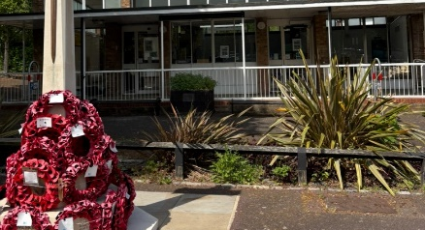


The Library
Community Update

Slide 2
A bit of background………….
Harold Wood Library was purposed designed by H Connolly, as part of an Essex County Council post war municipal development programme, intended to promote community wellbeing. The triangular shaped building had a community focused design prioritising usability, accessibility, supporting community as a social anchor. It was not a speculative investment…it was a municipal civic investment.
Good public buildings = stronger communities.

Slide 3
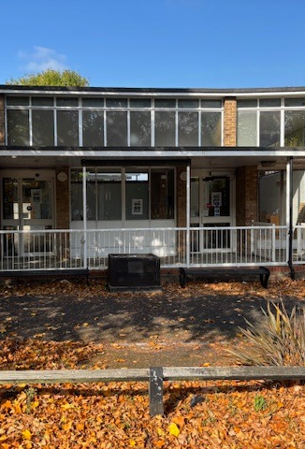
The Story So Far…
Library closed on 31st March due to Council cost saving measures.
Friends of Harold Wood Library Group established with positive support from other community groups.
The Harold Wood Foundation Draft project proposal submitted to Council
Successful application for the Library to become an Asset of Community Value.
£18,400 raised to pay towards rent and utilities.
A seven-year lease provisionally granted with a three-year break clause
Support from Corporates when the Library reopens

Slide 4
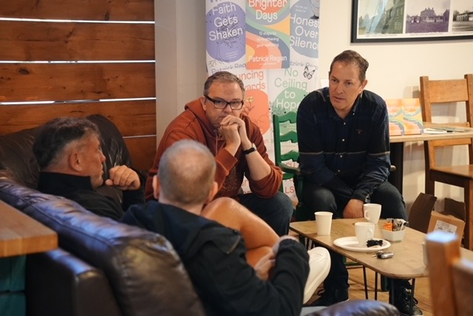

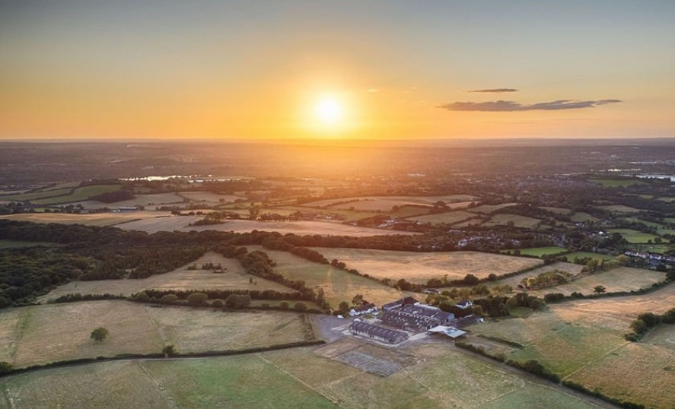
The Harold Wood Foundation
A community driven initiative focused on improving quality of life for Harold Wood residents.
Our Focus:
Strengthening community belonging
Promoting wellbeing
Supporting young people & men’s emotional health

Slide 5
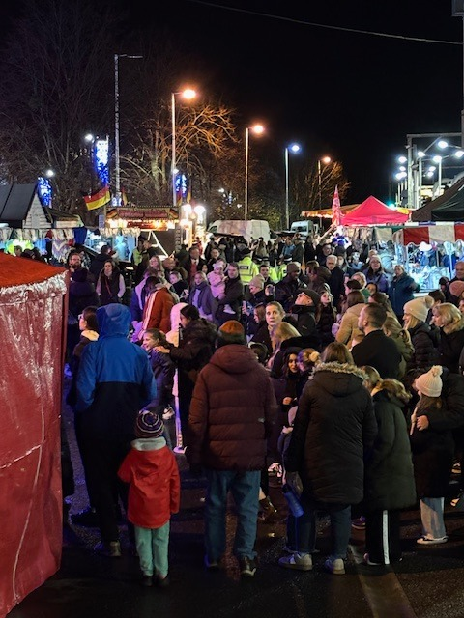

Current initiatives by the Harold Wood Foundation
Christmas Community Event, Station car park
Station artwork installations
Men’s mental wellbeing events
Delivering resilience coaching and enrichment for young people at Redden Court and Heathercourt/CentrePoint.
The repurposing of Harold Wood Library project
Working with CAP (Christians Against Poverty) to deliver fresh food hampers at Christmas for families connected to the Foodbank.

Slide 6

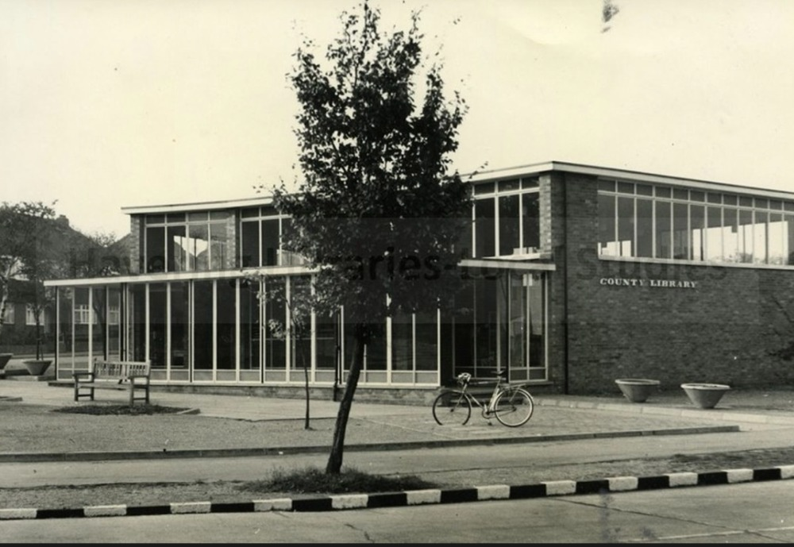
The Legal Bit
The Library now has ACV status as it furthers social wellbeing and interests of residents. (Localism Act 2011).
A request has been submitted to the Planning Department for the Library to be included on the Local Heritage list, citing its historic, architectural and social value. This designation would provide long term protection for the building, preventing demolition.

Slide 7
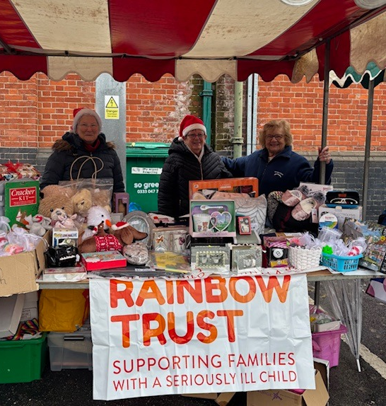
Our strength is in our community
z

Slide 8
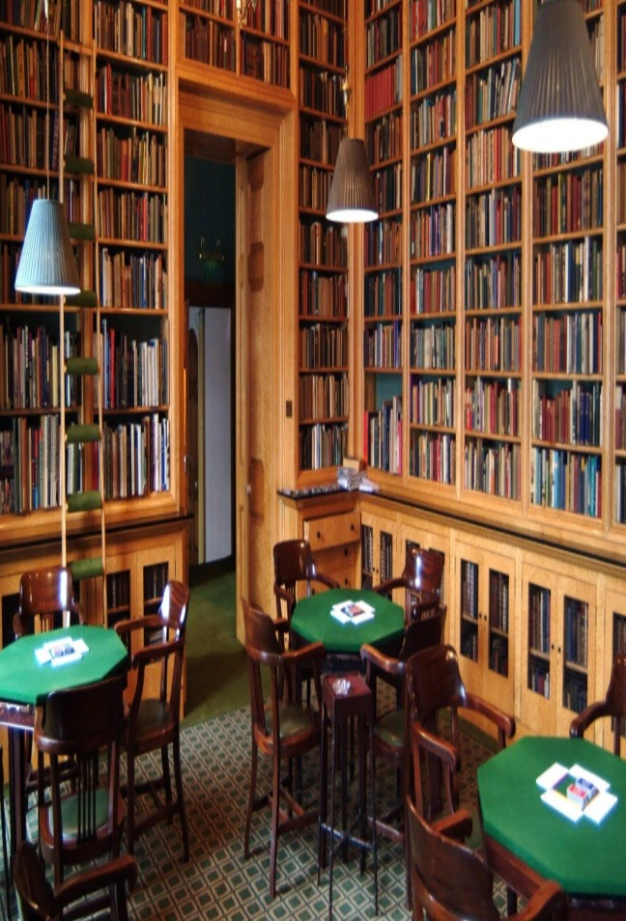
The Library- a new chapter
A renewed focus for our community, offering a lending collection of books, literacy support, book clubs, poetry events and author talks.
With extended hours, providing a welcoming space to share local stories, reduce loneliness and strengthen community connection

Slide 9


How you can help…
Get in touch contact contact@haroldwoodfoundation.org
Write to the Planning Department to request that the Library in included on the Local Heritage List.
Support fundraising campaigns, once the lease has been agreed.

Slide 10

By the community – for the community
z

Slide 11
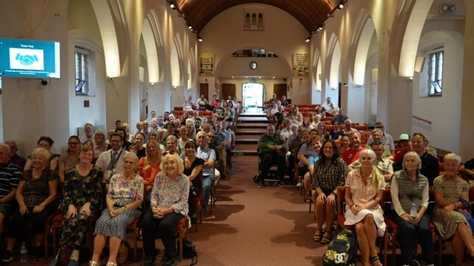
Thank You!
We appreciate your support and involvement in shaping the future of Harold Wood Library.

